Slide 1

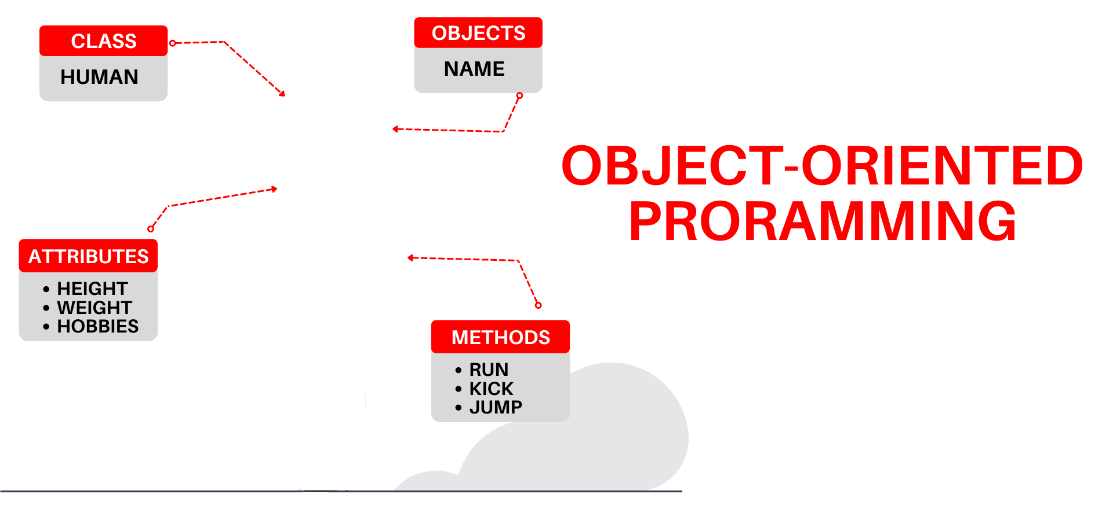

National University of Computer and Emerging Sciences
Spring 2022
Nimra Shahid
Lecture # 9 Inheritance

Slide 2
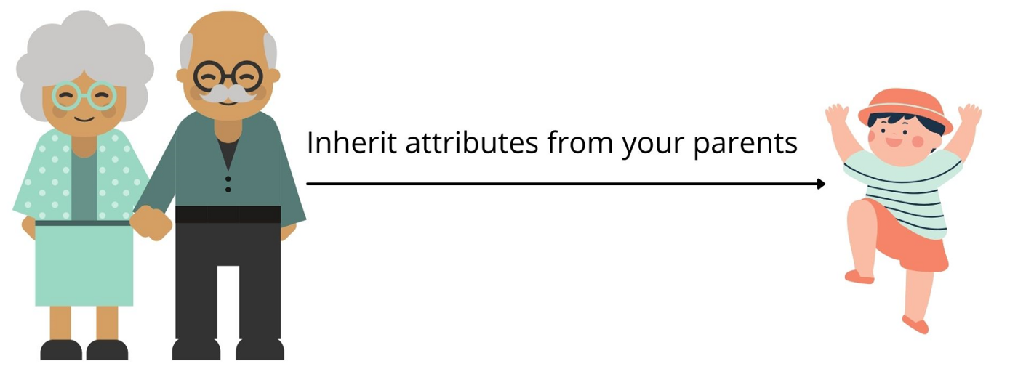
What Is Inheritance?
One of the most powerful features of OOP
Provides a way to create a new class from an existing class
The new class inherits all the capabilities of the existing class and can also add capabilities of its own.
The base class is unchanged by this process.
The new class is a specialized version of the existing class

Slide 3
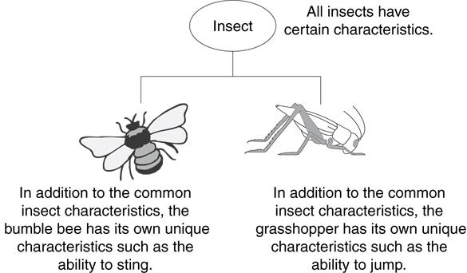
Example: Insects
Insect is generic
Bee and grasshopper are specific

Slide 4
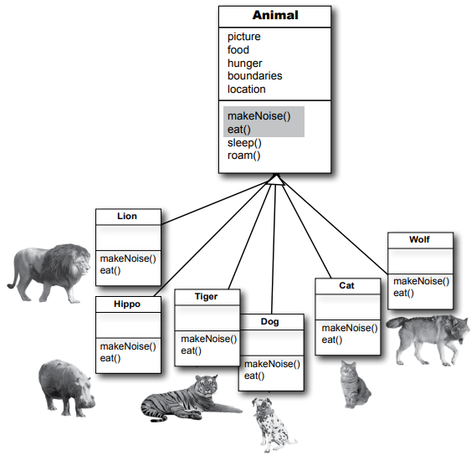
The “IS - A" Relationship
Inheritance establishes an “IS - A" relationship between classes.
A poodle is a dog
A car is a vehicle
A flower is a plant
A football player is an athlete

Slide 5
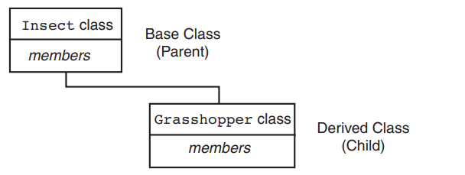
Introduction - Inheritance
Existing classes are called base classes
New classes are called derived classes

Slide 6
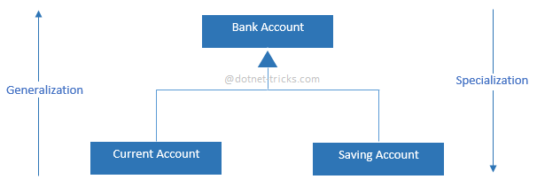
Introduction - Inheritance
Objects of derived classes are more specialized as compared to objects of their base classes

Slide 7
Animals: Class’s hierarchy
Specialization
Animal
Mammal
Reptiles
People
Dog
. . . . .
man
woman
Abstraction
John
Mary

Slide 8
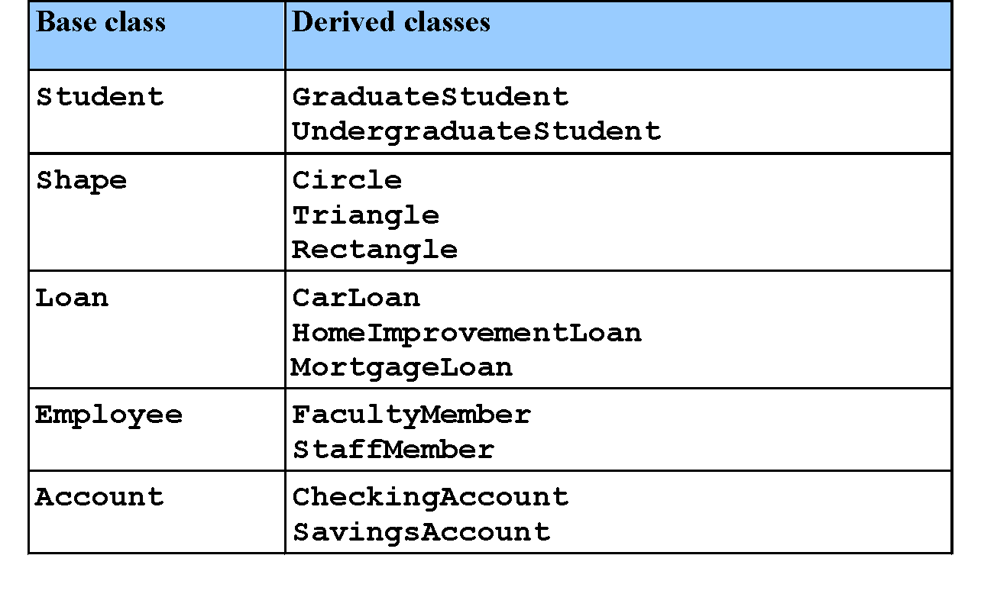
Inheritance Examples

Slide 9
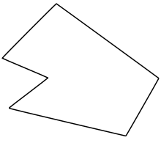
Why Inheritance?
class Rectangle{
private:
int numVertices;
float *xCoord, *yCoord;
public:
void set(float *x, float *y, int nV);
float area();
};
Polygon
Rectangle
Triangle
class Polygon{
private:
int numVertices;
float *xCoord, *yCoord;
public:
void set(float *x, float *y, int nV);
};
class Triangle{
private:
int numVertices;
float *xCoord, *yCoord;
public:
void set(float *x, float *y, int nV);
float area();
};

Slide 10
Why Inheritance?
Inheritance provides us a mechanism of software reusability which is one of the most important principles of software engineering
Show similarities
Easy modification by performing modification in one place
Avoid redundancy, leading to smaller and more efficient model, easier to understand

Slide 11
Inheritance – Terminology and Notation
Base class (or parent or superclass) – inherited from
Derived class (or child or subclass) – inherits from the base class
Notation:
class Student // base class
{
};
class UnderGrad : public Student
{ // derived class
};

Slide 12
Inheriting Data and Functions
All data members and member functions of base class are inherited to derived class, except
Constructors, destructors and = operator are not inherited

Slide 13
What Does a Child Class Have?
In the Student and underGrad example shown earlier:
An object of the derived class has:
all members defined in child class
all members of the parent class except constructors, destructors and operator=
An object of the derived class can use:
all public members defined in child class
all public members defined in parent class

Slide 14
//*********Inheritance Example************
//Car is "IS-A" Vehicle
class Vehicle {
private:
int speed;
public:
Vehicle() {
speed = 0;
cout << "\nVehicle constructor" << endl;
}
void setSpeed(int spd) {
speed = spd;
}
int getSpeed() {
return speed;
}
void start() {
cout << "\nStart Vehicle" << endl;
}
void stop() {
cout << "\nStop Vehicle" << endl;
}
};
class Car : public Vehicle {
private:
int wheels;
public:
Car() {
wheels = 0;
cout << "\nCar constructor" << endl;
}
void accelerate() {
int a = ++getspeed();
setspeed(a):
cout << "\nCar accelerating" << endl;
}
};
int main()
{
Car c1;
c1.start();
c1.accelerate();
c1.stop();
return 0;
}

Slide 15
Protected Members and Class Access
protected member access specification: like private, but accessible by objects of derived class
How inherited base class members
appear in derived class
Base class members
private: x
protected: y
public: z
public
base class
x is inaccessible
protected: y
public: z

Slide 16
//*********Inheritance Example************
//Car is "IS-A" Vehicle
class Vehicle {
protected:
int speed;
public:
Vehicle() {
speed = 0;
cout << "\nVehicle constructor" << endl;
}
void setSpeed(int spd) {
speed = spd;
}
int getSpeed() {
return speed;
}
void start() {
cout << "\nStart Vehicle" << endl;
}
void stop() {
cout << "\nStop Vehicle" << endl;
}
};
class Car : public Vehicle {
private:
int wheels;
public:
Car() {
wheels = 0;
cout << "\nCar constructor" << endl;
}
void accelerate() {
speed++; //works, protected
cout << "\nCar accelerating" << endl;
}
};
int main()
{
Car c1;
c1.start();
c1.accelerate();
c1.stop();
return 0;
}

Slide 17
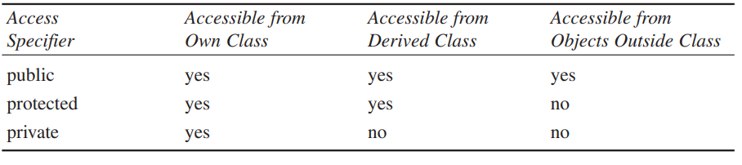
Protected Members and Class Access
protected member access specification: like private, but accessible by objects of derived class

Slide 18
Protected Members and Class Access
protected member access specification: like private, but accessible by objects of derived class
Class access specification: determines how private, protected, and public members of base class are inherited by the derived class

Slide 19
Inheritance Example 1
class Polygon{
protected:
int numVertices;
float *xCoord, float *yCoord;
public:
void set(float *x, float *y, int nV);
};
Polygon
Rectangle
Triangle
class Rectangle : public Polygon{
public:
float area();
};
class Triangle : public Polygon{
public:
float area();
};

Slide 20
Inheritance Example 2
Point
x
y
class Point{
protected:
int x, y;
public:
void set (int a, int b);
};
Circle
3DPoint
x
y
r
x
y
z
class Circle : public Point{
private:
double r;
};
class 3DPoint: public Point{
private:
int z;
};

Slide 21
Define its Own Members
The derived class can also define its own members, in addition to the members inherited from the base class
class Point{
protected:
int x, y;
public:
void set(int a, int b);
};
Point
x
y
x
y
r
Circle
class Circle{
protected:
int x, y;
private:
double r;
public:
void set(int a, int b);
void set_r(double c);
};
class Circle : public Point{
private:
double r;
public:
void set_r(double c);
};

Slide 22
Dangers of Protected
You should know that there’s a disadvantage to making class members protected.
Say you’ve written a class library, which you’re distributing to the public. Any programmer can access protected members of your classes simply by deriving other classes from them.
This makes protected members considerably less secure than private members.
To avoid corrupted data, it’s often safer to force derived classes to access private data in the base class using only public setters and getters.

Slide 23
Constructors and Destructors in Base and Derived Classes
Constructors and destructors of Base class are NOT inherited
Derived classes can have their own constructors and destructors
When an object of a derived class is created, the base class’s constructor is executed first, followed by the derived class’s constructor
When an object of a derived class is destroyed, its destructor is called first, then that of the base class

Slide 24
Constructor Rules for Derived Classes
The default constructor and the destructor of the base class are always called when a new object of a derived class is created or destroyed.
class A {
public:
A ( )
{ cout<< “A default”<<endl; }
A (int a)
{ cout<<“A parametrized”<<endl; }
};
class B : public A
{
public:
B ( ) {
cout<<“B default”<<endl; }
};
B obj;
output:
A default
B default

Slide 25
Constructor Rules for Derived Classes
The default constructor and the destructor of the base class are always called when a new object of a derived class is created or destroyed.
class A {
public:
A ( )
{ cout<< “A default”<<endl; }
A (int a)
{ cout<<“A parametrized”<<endl; }
};
class B : public A
{
public:
B (int a) {
cout<<“B parametrized”<<endl; }
};
B obj(1);
output:
A default
B parametrized

Slide 26
Passing Arguments to Base Class Constructor
Allows selection between multiple base class constructors
Specify arguments to base constructor on derived constructor heading:
Inline constructor syntax:
(Derived Class) (Base Class)
Square(int side) : Rectangle(side, side)
Can also be done with out-of-line constructors
Square::Square(int side):Rectangle(side, side)
Must be done if base class has no default constructor

Slide 27
Passing Arguments to Base Class Constructor
derived class constructor
base class constructor
Square::Square(int side):Rectangle(side,side)
derived constructor parameter
base constructor parameters

Slide 28
Constructor Rules for Derived Classes
You can specifically call a constructor of the base class other than the default constructor
DerivedClassCon ( derivedClass args ) : BaseClassCon ( baseClass args )
{ DerivedClass constructor body }
class A {
public:
A ( )
{ cout<< “A default”<<endl; }
A (int a)
{ cout<<“A parametrized”<<endl; }
};
class C : public A {
public:
C (int a) : A(a) {
cout<<“C parametrized”<<endl; }
};
C test(1);
output:
A parametrized
C parametrized

Slide 29
//*********Inheritance Example************
//Square is "IS-A" Rectangle (with l = w)
class Rectangle {
protected:
int length;
int width;
public:
Rectangle() {
length = 0; width = 0;
cout << "\nRectangle default" << endl;
cout << "Length " << length << endl;
cout << "Width " << width << endl;
}
Rectangle(int l, int w) {
length = l; width = w;
cout << "\nRectangle parametrized" << endl;
cout << "Length " << length << endl;
cout << "Width " << width << endl;
}
~Rectangle() {
cout << "\nRectangle destructor" << endl;
}
};

Slide 30
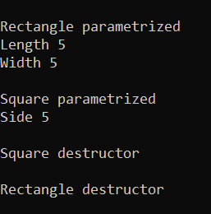
class Square : public Rectangle{
private:
int side;
public:
Square() {
side = 0;
cout << "\nSquare default" << endl;
cout << "Side " << side << endl;
}
Square(int s) : Rectangle(s,s) {
side = s;
cout << "\nSquare parametrized" << endl;
cout << "Side " << side << endl;
}
~Square() {
cout << "\nSquare destructor" << endl;
}
};
int main()
{
Square obj(5);
return 0;
}

Slide 31
Class Derivation
Point
class Point{
protected:
int x, y;
public:
void set (int a, int b);
};
3DPoint
Sphere
class 3DPoint : public Point {
private:
double z;
};
class Sphere : public 3DPoint{
private:
double r;
};
Point is the base class of 3D-Point, while 3DPoint is the base class of Sphere

Slide 32
Order of execution of Constructors/Destructors
Chain of constructor calls:
Point 🡪 Circle 🡪 Cylinder
Point constructor executes first
Then circle and last Cylinder

Slide 33
Order of execution of Constructors/Destructors
Chain of destructor calls
Reverse order of constructor chain
Cylinder 🡪 Circle 🡪 Point
Destructor of derived-class called first
Destructor of next base class up hierarchy next
Continue up hierarchy until final base reached
After final base-class destructor, object removed from memory

Slide 34
Example
class Point
{
protected:
int x, y;
public:
Point(int ,int );
void display(void);
~Point() { cout<<"\nPoint Class Destructor\n"; }
};
Point::Point(int a,int b) {
cout<< "\nPoint Class Constructor\n";
x = a;
y = b;
}
void Point::display(void) {
cout<< "point = [" << x <<","<< y <<"]";
}

Slide 35
Example – cont.
class Circle : public Point
{
protected:
double radius;
public:
Circle(int ,int ,double);
void display(void);
~Circle() { cout <<"\n Circle Class Destructor \n"; }
};
Circle::Circle(int a,int b,double c):Point(a,b) {
cout <<"\n Circle Class Constructor “<<endl;
radius = c;
}
void Circle::display(void) {
Point::display(); //Parent class display called
cout <<" radius = “ << radius;
}

Slide 36
Example – cont.
class Cylinder: public Circle
{
double height;
public:
Cylinder(int ,int ,double ,double);
void display(void);
double GetVolume(void);
~Cylinder() { cout<<"\nCylinder Class Destructor\n"; }
};
Cylinder::Cylinder(int a,int b,double r,double h):Circle(a,b,r) {
cout << "\nCylinder Class Constructor“<<endl;
height=h;
}
double Cylinder::GetVolume(void) {
return 3.14 * radius * radius * radius;
}
void Cylinder::display(void) {
Circle::display();
cout<<" height = "<<height;
}

Slide 37
Example – cont.
int main(void)
{
Cylinder c(3, 4, 2.5, 3.7);
return 0;
}
Output:
Point Class Constructor
Circle Class Constructor
Cylinder Class Constructor
Cylinder Class Destructor
Circle Class Destructor
Point Class Destructor

Slide 38
Any Question?

Slide 39
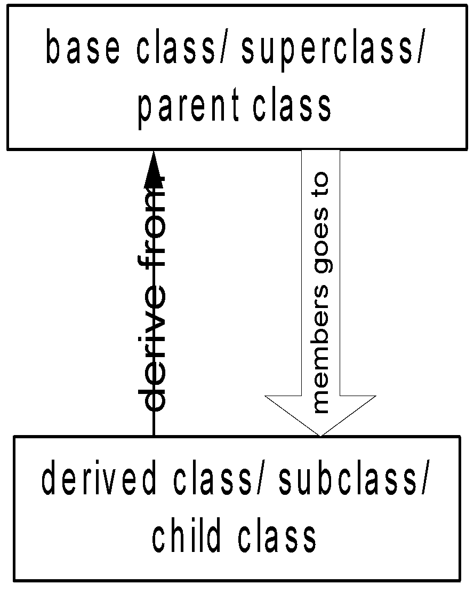
Data vs Class Access Specifier
Two levels of access control over class members
class definition
inheritance type
class Point{
protected: int x, y;
public: void set(int a, int b);
};
class Circle : public Point{
… …
};

Slide 40
Types of inheritance/ Class access specifier
public
private
protected

Slide 41
Public Inheritance
With public inheritance,
public and protected members of the base class become respectively public and protected members of the derived class
class derived : public base{
… …
};

Slide 42
Protected Inheritance
Public and protected members of the base class become protected members of the derived class.
class derived : protected base{
… …
};

Slide 43
Private Inheritance
With private inheritance, public and protected members of the base class become private members of the derived class.
class derived : private base{
… …
};

Slide 44
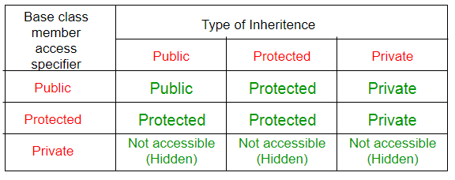
public, protected and private Inheritance

Slide 45
Inheritance vs. Access
How inherited base class members
appear in derived class
Base class members
private: x
protected: y
public: z
private
base class
x is inaccessible
private: y
private: z
private: x
protected: y
public: z
protected
base class
x is inaccessible
protected: y
protected: z
private: x
protected: y
public: z
public
base class
x is inaccessible
protected: y
public: z

Slide 46
Class Access Specifiers – When to use?
public – object of derived class can be treated as object of base class (not vice-versa)
protected – more restrictive than public, but allows derived classes to know details of parents
private – prevents objects of derived class from being treated as objects of base class.

Slide 47
Method Overriding
A derived class can override methods defined in its parent class.
the method in the subclass must have the identical signature to the method in the base class.
a subclass implements its own version of a base class method.
class A {
protected:
int x, y;
public:
void print ()
{ cout<<“From A”<<endl; }
};
class B : public A {
public:
void print ()
{cout<<“From B”<<endl;}
};

Slide 48
Method Overriding
class Circle : public Point{
private: double r;
public:
//function overriding
//In inheritance base class functions are not overloaded. They are overridden.
void set (int a, int b, double c) {
Point :: set(a, b); //same name function call
r = c;
}
//function overriding
void print(){cout << “hello”; }
};
class Point{
protected:
int x, y;
public:
void set(int a, int b)
{ x=a; y=b; }
void foo ();
void print();
};
Point A;
A.set(30,50); // from base class Point
A.print(); // from base class Point
Circle C;
C.set(10,10,100); // from class Circle
C.foo (); // from base class Point
C.print(); // from class Circle

Slide 49
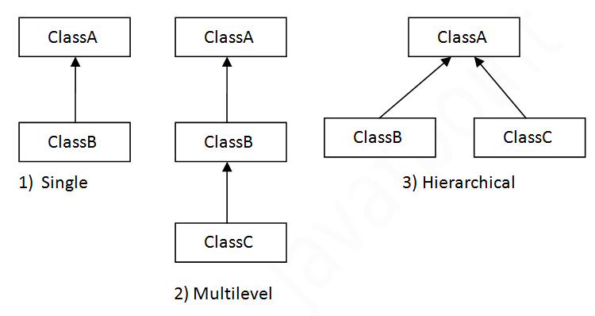
Types of Inheritance
Single inheritance
Inherits from one base class
Multi-level inheritance
Chain of inheritance
Multiple inheritance
Inherits from multiple classes

Slide 50
Types of Inheritance: University Example
CommunityMember
Single Inheritance
Employee
Student
Alumnus
Single inheritance
Multi-level Inheritance
Faculty
Staff
Single inheritance
Multi-level Inheritance
Administrator
Teacher
Single inheritance
Multiple Inheritance
AdministratorTeacher
Multiple inheritance

Slide 51
Multiple Inheritance
Employee
Student
Salaried
Graduate_Assistant

Slide 52
What is Multiple Inheritance?
If class A inherits from more than one class,
i.e., A 🡪 (B1, B2, ..., Bn), we speak of multiple inheritance.
This may introduce naming conflicts:
if at least two of its base classes define properties (data members or member functions) with the same name

Slide 53
//simple example showing multiple inheritance
class A {
public:
void fun1(void) { cout<<"fun1"; }
};
class B {
public:
void fun2(void) { cout<<"fun2"; }
};
class derived: public A, public B {
public:
void funderived(void) { cout<<"func derived";}
};
void main(void) {
derived der;
der.fun1();
der.fun2();
der.funderived();
}

Slide 54
Ambiguity in Multiple Inheritance
class Student {
int id;
int age;
public:
int GetAge() const { return age; }
int GetId() const { return id; }
void SetAge( int n ) { age = n; }
void SetId( int n ) { id=n; }
};

Slide 55
Ambiguity in Multiple Inheritance
class Employee {
private:
int age;
int id;
public:
int GetAge() const { return age; }
int SetAge( int n ) { age = n; }
void SetId( int n) { id=n; }
int GetId(void) const { return id; }
};

Slide 56
Ambiguity in Multiple Inheritance
class Salaried : public Employee {
float salary;
public:
float GetSalary() const { return salary; }
void SetSalary( float s ) { salary=s; }
};
class GradAssistant :public Student, public Salaried {
public:
void Display() const
{
cout<<GetId()<<","<<GetSalary()<<","<<GetAge(); //ambiguity
}

Slide 57
Ambiguity in Multiple Inheritance
int main(void) {
GradAssistant ga;
ga.SetAge(20); //ambiguity
ga.SetId(15); //ambiguity
ga.Display(); //ambiguity inside display()
}
//program will not compile and will generate errors

Slide 58
What is the solution?
Call functions explicitly by specifying name of class and using scope resolution operator to remove ambiguity:
Direct solution:
Student::SetAge() or Salaried::SetAge()

Slide 59
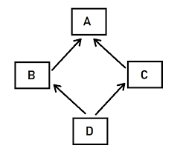
The Diamond Problem
class A {
public:
void Foo() {}
}
class B : public A {}
class C : public A {}
class D : public B, public C {}
D d;
d.Foo();
is this B's Foo() or C's Foo() ?? ambiguous

Slide 60
What is the solution?
Call functions explicitly by specifying name of class and using scope resolution operator to remove ambiguity:
Direct solution:
Student::SetAge() or Salaried::SetAge()
2. Virtual inheritance

Slide 61
Solution (virtual inheritance)
class A {
public: void Foo() {}
}
class B : public virtual A {
}
class C : public virtual A {
}
class D : public B, public C {
}
D d;
d.Foo(); // no longer ambiguous

Slide 62
Virtual Inheritance
Virtual inheritance is a C++ technique that ensures that only one copy of common base class's member variables are inherited by second-level derivatives (a.k.a. grandchild derived classes)

Slide 63
Another example
class PoweredDevice
{
public:
PoweredDevice(int nPower)
{
cout << "PoweredDevice: " <<
nPower << endl;
}
};

Slide 64
class Scanner: public PoweredDevice {
public:
Scanner(int nScanner, int nPower) : PoweredDevice(nPower)
{
cout << "Scanner: " << nScanner << endl;
}
};
class Printer: public PoweredDevice {
public:
Printer(int nPrinter, int nPower) : PoweredDevice(nPower)
{
cout << "Printer: " << nPrinter << endl;
}
};

Slide 65
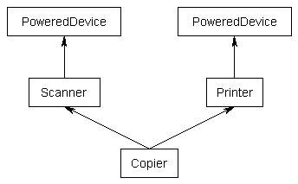
Another example
class Copier: public Scanner, public Printer
{
public:
Copier(int nScanner, int nPrinter, int nPower) : Scanner(nScanner, nPower), Printer(nPrinter, nPower)
{
}
};

Slide 66
Another example
int main()
{
Copier cCopier(1, 2, 3);
}
What should be the output?
PoweredDevice: 3
Scanner: 1
PoweredDevice: 3
Printer: 2

